Slide 1


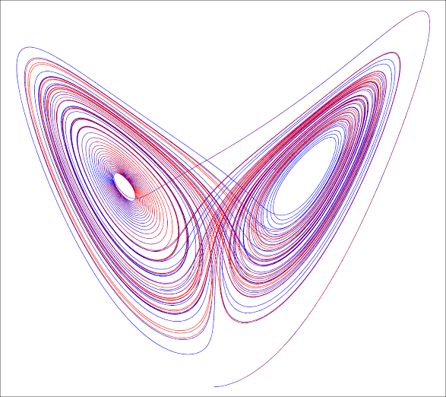
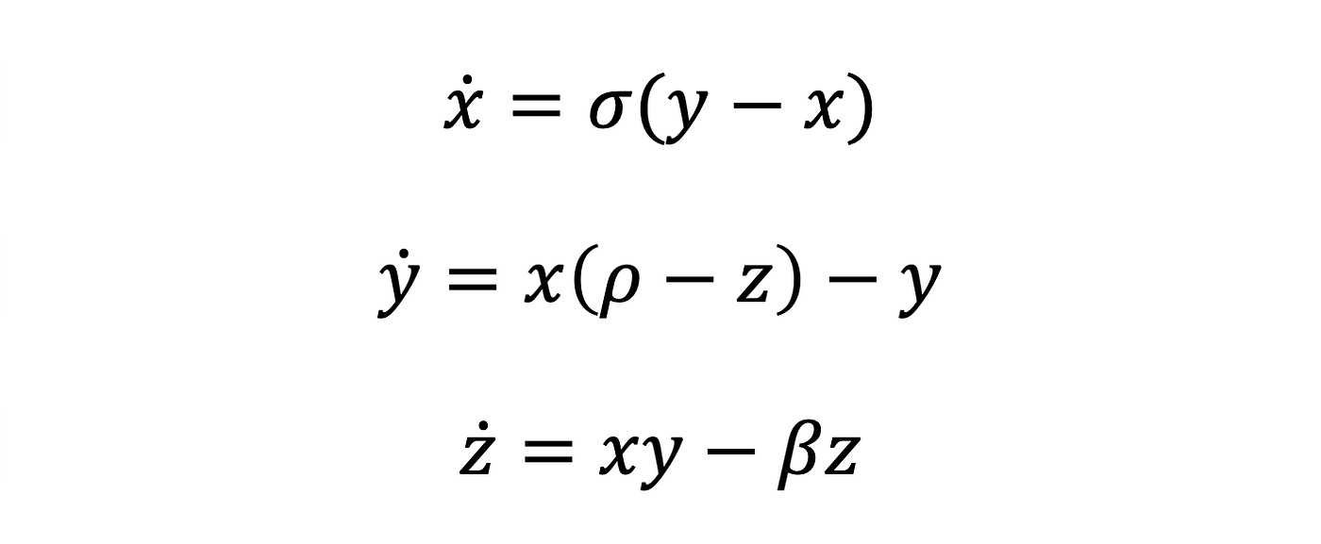
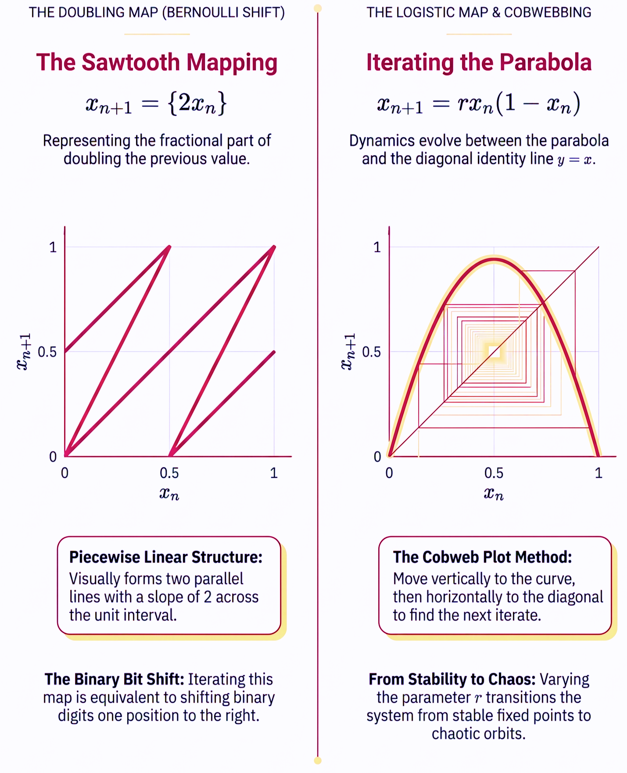
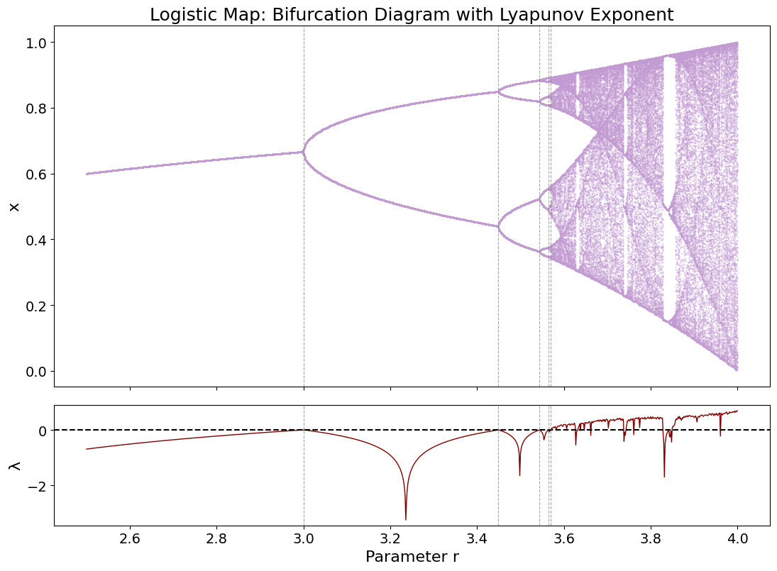
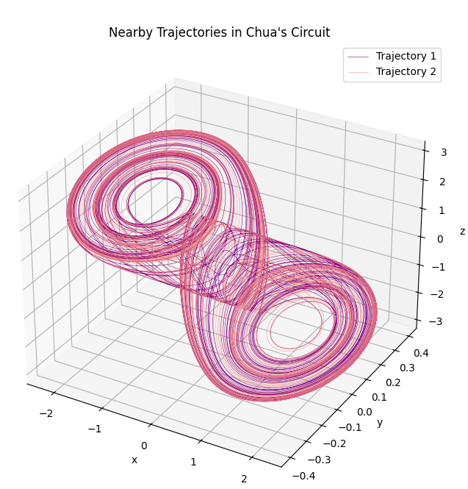
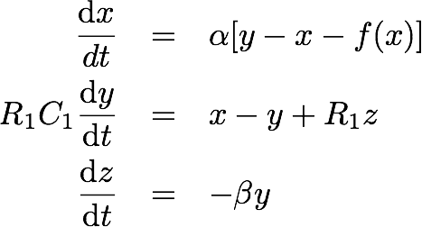
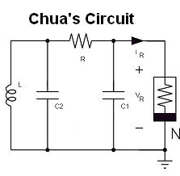



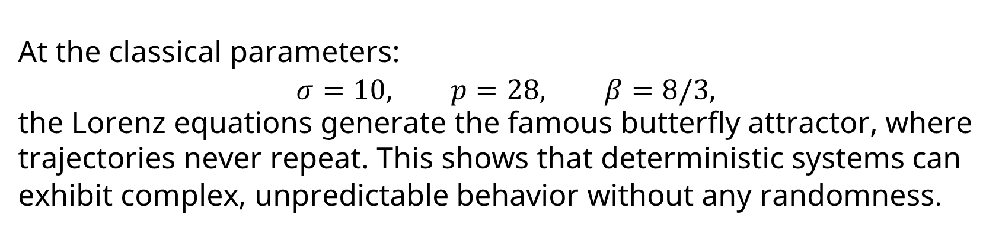
The Mathematics of Chaos: From Simple Maps to Chua’s Circuit.
Zainab Fawad, Waqas Ali Azhar*
BCP Tipu Sultan, Department Of Mathematics, SBASSE, LUMS
Introduction
The ‘Butterfly Effect’
Chaos theory examines how deterministic systems can produce seemingly unpredictable behavior due to nonlinearity and sensitivity to initial conditions. Although governed by fixed mathematical laws, these systems can evolve into complex, chaotic patterns. This project investigates how chaos emerges from nonlinearity in deterministic systems using mathematical models and computational simulations.
The Lorenz system introduced continuous-time chaos through three nonlinear differential equations. It revealed the Butterfly Effect, where tiny changes in initial conditions lead to vastly different outcomes. Although the system is deterministic, it produces complex, non-repeating motion confined within the iconic butterfly-shaped.
SIMPLE RULES
NON-LINEARITY
CHAOS
COMPLEX BEHAVIOR
The Lorenz Equations & Attractor:
Mathematical Foundations
Chaos theory begins with deterministic dynamical systems, where future behavior is entirely determined by mathematical rules. Through mathematical models such as the circle map, the doubling map and the logistic map, this study explores how simple nonlinear equations produce increasingly complex behavior. These models lay the foundation to understanding complex systems like The Lorenz Attractor by explaining nonlinearity, sensitive dependance and bifurcations. Figure 1.1 and 1.2 show the Doubling Map and the Logistic Map
The Doubling Map:
${ x}_{\left\{n+1\right\}}=2x_{n}$
The Logistic Map:
$x_{\left\{n+1\right\}}=rx_{n}\left(1−x_{n}\right)$
These equations model the
simple mathematics that
eventually cause such
complex behavior.
Fig 1.4: The famous Butterfly attractor and the Lorenz equations
At the classical parameters:
$$σ=10, p=28, β=8/3,$$
the Lorenz equations generate the famous butterfly attractor, where trajectories never repeat. This shows that deterministic systems can exhibit complex, unpredictable behavior without any randomness.
Application: Chua’s Circuit
Chua's Circuit is the simplest physical electronic circuit capable of generating chaos. Its nonlinear resistor introduces the nonlinearity required for chaotic motion, producing the characteristic double-scroll attractor. Like the Lorenz system, nearby trajectories diverge rapidly while remaining confined within a bounded region, demonstrating the Butterfly Effect in an electrical system. This illustrates that the same mathematical principles governing chaotic maps and atmospheric models also apply to real engineering systems, with applications in secure communications, nonlinear electronics, and signal processing.
Figures 1.1 and 1.2: The Doubling and Logistics maps and the concepts they help visualize.
Route to Chaos
(a) Nearby Trajectories in Chua’s Circuit: Double-scroll Attractor
(b) Chua’s dimensionless equations
(c) Chua’s Circuit
Components:
Capacitor $C_{1}$: Stores electrical energy.
Capacitor $C_{2}$
Inductor $L$: Stores magnetic energy (current $i_{L}$).
Linear Resistor $R$
Nonlinear Resistor (Chua's Diode): Introduces nonlinearity.
Fig 1.3: Period-doubling cascade leading to deterministic chaos and corresponding Lyapunov Exponent values.
Increasing nonlinearity causes a deterministic system to transition from order to chaos through a sequence of period-doubling bifurcations. In the Logistic Map, as the control parameter increases, a stable equilibrium becomes oscillations between 2, 4, 8, and progressively more states before entering the chaotic regime.
Another intriguing concept is the Feigenbaum constant, where the ratio of spacing between successive bifurcations approaches its value:
$$δ≈4.669$$
The Lyapunov exponent ($λ$) measures how rapidly nearby trajectories diverge. Negative values indicate stable behavior, while positive values identify chaotic dynamics.
Together, these tools explain when and how deterministic systems become chaotic, shown in Figure 1.3
Fig 1.5: (a) The double scroll attractor showing two nearby trajectories and their unpredictable, varying paths. (b) The equations modelling Chua’s circuit. (c) The circuit and its components.
Conclusions & Future Work
This study demonstrated that nonlinearity enables simple deterministic systems to exhibit chaotic behavior. The logistic map illustrated the transition to chaos, the Lorenz system revealed the Butterfly Effect, and Chua's circuit showed that these same principles apply to real engineering systems. Future work could explore applications of chaos theory in robotics, aerospace control, and other complex engineering systems.
**All figures and graphs simulated using python during the duration of the program

Slide 2


